Slide 1

Branch - CSE Python Programming
Lecture – 6 Conditional Statements
By
Dr. Smita Tiwari
Assistant Professor
Department of Computer Science and Engineering
School of Engineering & Technology

Slide 2
Decision-Making Statements/Conditional Statements in Python: An Overview
Programming requires decision-making statements because they let programs decide what to do and run distinct code blocks according to predefined conditions.
Programmers can control how a program executes depending on a variety of conditions by using these statements.
The foundation of decision-making is condition checking.
In Python, decision-making is performed by using conditional statements

Slide 3
Types of decision-making statements in python
There are four types of decision-making statements in Python language, those are
If statements in python
If else statement in python
Nested if else statement in Python
if-elif-else Ladder in Python

Slide 4
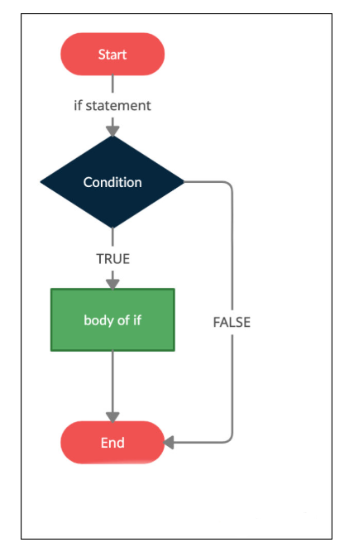

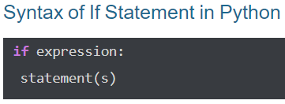
If statements in python
1. If statements in python
The simplest structure for making decisions is an if statement, which only permits the execution of a code block if a predetermined condition is met.
The if keyword is followed by an indented block of statements that are executed if the condition is assessed and found to be true.
If not, the code skips the if block.
Example:
num = 8
if num > 0:
print("The number is positive.")

Slide 5
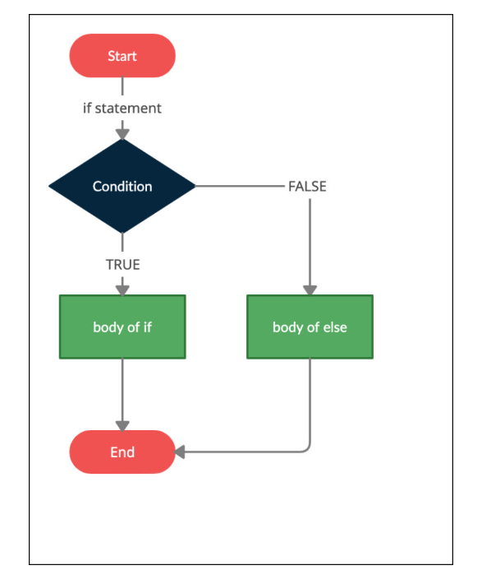
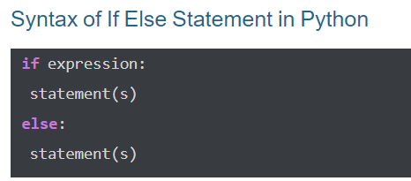
If else statement in Python
2. If else statement in python
If the condition in the if block evaluates to false, the if-else statement executes an alternate block of code.
This block of alternatives is introduced by the else keyword.
Example:
num = 11
if num % 2 == 0:
print("The number is even.")
else:
print("The number is odd.")

Slide 6
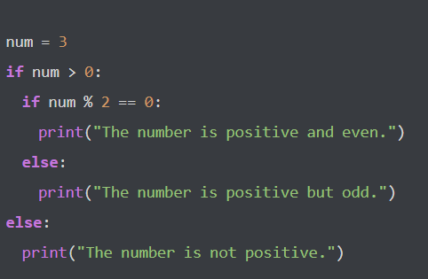
Nested if else statement in Python
3333333333333335
3. Nested if else statement in Python
Python enables the nesting of decision-making statements, which facilitates the development of more complex decision logic.
A hierarchy of conditions can be created by an if or if-else block within another if or if-else block.
Example:

Slide 7
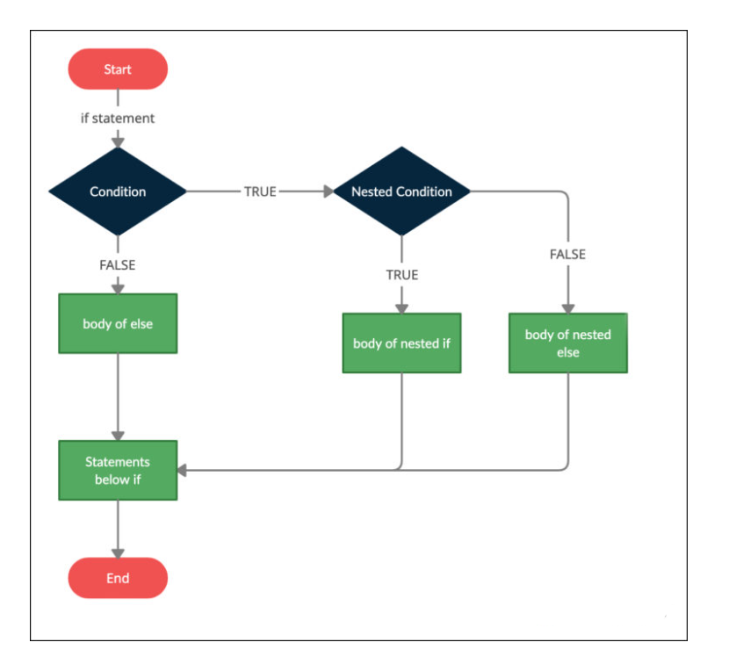
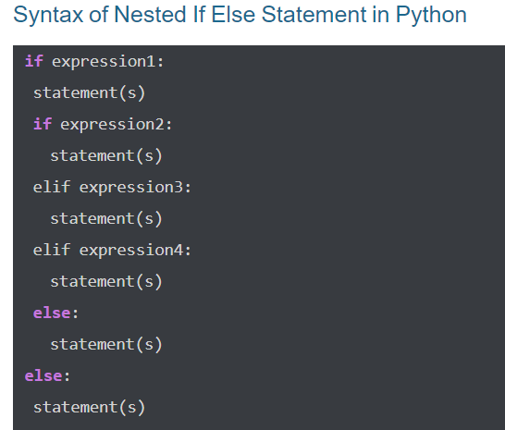
Nested if else statement in Python

Slide 8
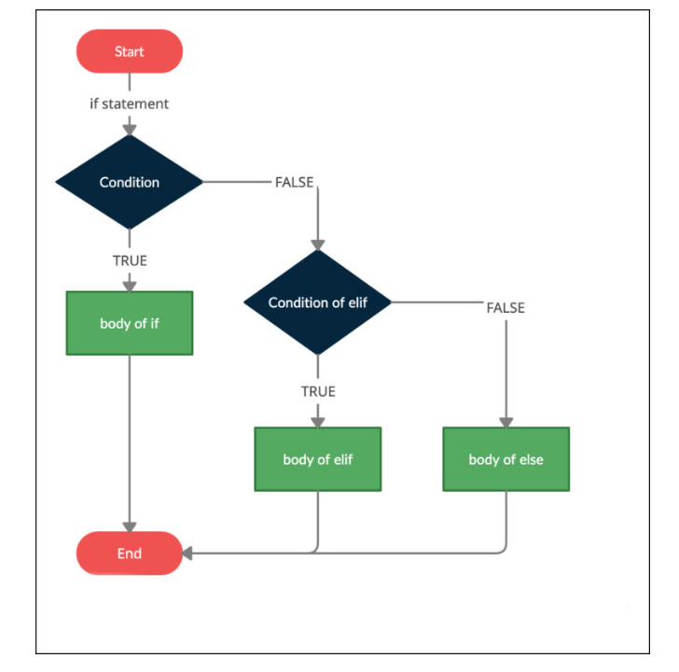
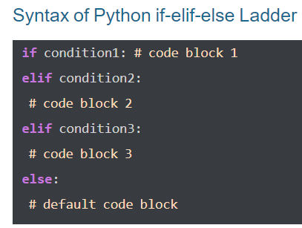
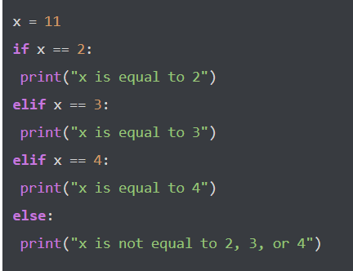
Python if-elif-else Ladder
4. Python if-elif-else Ladder
An if-elif-else ladder is an order of if statements connected by elif statements.
This enables you to check for numerous conditions and run separate code blocks based on which condition is met.
Example:

Slide 9
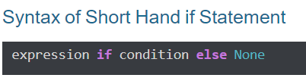
Short Hand if Statement
Short Hand if Statement
In Python, a shorthand if statement is an easy way to write an if statement with a single expression. It is very useful when you have a basic condition to verify and only one action to take if that condition is met.
Example:
i = 21 if i > 15: print("i is greater than 15")

Slide 10
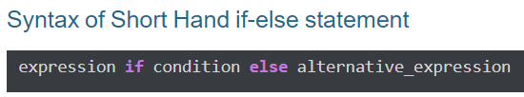
Short Hand if-else statement
Short Hand if-else statement
If-else statements in Python are written in a more clear manner using short-hand if-else statements. They are useful when there is just one expression to evaluate for each branch of the if-else statement.
Example:
age = 18
message = "You can vote" if age >= 18 else "You cannot vote yet" print(message)

Slide 11
Break, Pass, and Continue Statements in Python
In Python, "break", "continue", and "pass" are control flow statements used within loops and conditional statements.
"break" is used to exit a loop prematurely if a certain condition is met. It terminates the loop entirely and continues with the next statement after the loop.
"continue" is used to skip the rest of the current iteration of a loop and continue with the next iteration. It effectively jumps to the next iteration without executing the remaining code in the loop's body.
"pass" is a null operation; it doesn't do anything. It's used as a placeholder when a statement is syntactically required but no action is needed.

Slide 12
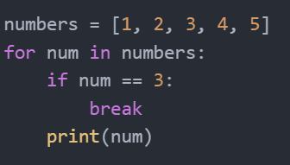
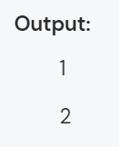
The Break Statement in Python
The break statement allows to prematurely exit from a loop, regardless of whether it is a for loop or a while loop.
When encountered, the break statement terminates the current loop iteration and transfers the program's control to the statement immediately following the loop.
Example:
In this code example, there is a list of numbers.
The loop iterates over each number, and when the value of num becomes 3, the break statement is encountered.
As a result, the loop is terminated, and the program control moves to the line following the loop.
Therefore, only the numbers 1 and 2 are printed.

Slide 13
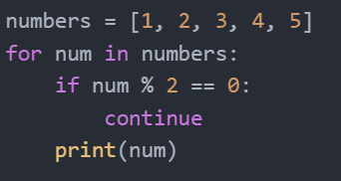
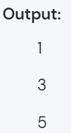
The Continue Statement in Python
The continue statement allows you to skip the remaining statements within a loop iteration and move to the next iteration.
The continue statement is useful when we want to exclude certain elements from processing within a loop.
Example:
In the example, the loop iterates over each number in the list.
If a number is even (divisible by 2), the continue statement is encountered, skipping the remaining statements within that iteration.
As a result, only odd numbers are printed.

Slide 14
The Pass Statement in Python
The pass statement is a placeholder statement that does nothing.
It is used when we need a statement syntactically but don't want to perform any action.
The pass statement is often used as a placeholder while developing code, allowing us to leave functions or classes empty until we are ready to implement them.
Examples:
# Example: Define a function with no implementation yet
def placeholder_function():
pass # Placeholder for future implementation
# Example: Use pass in a conditional block
x = 10
if x > 5:
pass # Placeholder for future code
else:
print("x is not greater than 5")
# Example: Define an empty class
class EmptyClass:
pass # Placeholder for future class definition
In each of these examples, the "pass" statement is used to indicate that the function, class, or conditional block has been defined but lacks implementation. This allows the code to be syntactically correct while awaiting further development.

Slide 15
THANK YOU

